Slide 1
Quest AI
Business Plan
Randhawa Yuvraj • 2025

Slide 2
Business Mission
To make learning more effective and enjoyable for students by turning education into a fun, AI-powered adventure

Slide 3
Business Description
QuestAI is a fun, gamified learning app designed and created to help students learn more effectively and efficiently with the same personalisation as a personal teacher. It uses artificial intelligence to personalise lessons and study questions based on each student's strengths and weaknesses and their question history, making the learning experience feel like an adventure.

Slide 4
Business Description (cont.)
Students complete quests and can earn points, unlock levels, and receive rewards and prizes as they progress through the curriculum. QuestAI is made and designed for primary and high-school students who enjoy interactive, game-style learning and need that extra motivation to stay engaged. By combining adaptive AI technology with fun challenges, QuestAI makes studying way easier, more enjoyable, and way more effective.

Slide 5
Product: Goods/Services & Key Features
QuestAI provides a learning app that helps students study through fun, game-styled activities. The app includes personalised lessons, practice questions, quizzes, and AI-generated feedback based on each student's learning level.
Key features include:
Points and level-up system connected to world leaderboard
Daily quests and streak rewards
Progress tracking
Personalised study path that updates automatically

Slide 6
Product Differentiation
How QuestAI is Different:
QuestAI uses real-time adaptive AI to personalise every lesson and question automatically. Other apps normally use fixed levels, generic worksheets, or the same questions for every student. QuestAI adjusts difficulty instantly, just like a real teacher would and can generate unique questions based on the student's needs.
Another difference is the strong gamification system—points, levels, badges, and mini-quests—which keeps students motivated to stay engaged longer.

Slide 7
Differentiation & Key Benefits
Why QuestAI Stands Out:
QuestAI uses real-time adaptive AI to personalise every lesson and question automatically, adjusting difficulty instantly like a real teacher. The strong gamification system with points, levels, badges, and mini-quests keeps students motivated. Duolingo uses gamification but is limited to language learning, while Khan Academy has adaptive practice but no game quests or rewards. Existing tools focus on either skills or practice but do not combine AI adaptiveness and full gamified learning like QuestAI.
Core Benefits:
Students gain more engagement since learning feels like playing a game, receive personalised learning tailored to their level, experience confidence boosts from completing quests, achieve faster learning through targeted weak area focus, and benefit from progress tracking through dashboards for students, parents, and teachers.

Slide 8
Improving Productivity
QuestAI improves business productivity by using automated systems to reduce workload, save time, and streamline operations. The AI automatically generates questions, updates difficulty levels, and manages large amounts of student data without needing manual input.
The business also improves productivity by using cloud servers to handle most processing, which lowers hardware costs and reduces maintenance time. Automated reporting tools help the team track bugs, performance, and user activity efficiently.

Slide 9
Productivity & Team Management
Improving Business Productivity:
QuestAI improves productivity through automated systems that reduce workload and streamline operations. The AI automatically generates questions, updates difficulty levels, and manages student data without manual input. Cloud servers handle most processing, lowering hardware costs and maintenance time, while automated reporting tools track bugs and performance efficiently. Duolingo increases productivity using streaks and XP to keep learners active longer, while Google Classroom improves productivity through automation and auto-marking quizzes.
Team Structure & Organization:
QuestAI operates with a small, organised team where developers create and update the app, designers handle visual layout, and support staff assist users. The team uses Trello and Slack for communication and project management. Canva and Khan Academy use similar collaborative platforms to keep teams coordinated and productive, demonstrating the effectiveness of this organizational approach.

Slide 10
Marketing & Target Demographics
Primary Market Focus:
QuestAI is aimed at primary students aged 8 to 12 and high-school students aged 13 to 18 who enjoy game-style learning and need more motivation to study. The platform also targets parents seeking modern educational tools and schools wanting digital learning options for their students.
Geographic & Economic Profile:
QuestAI's primary market is located in Australia with possible expansion globally. The target demographic includes middle-income families that can afford learning apps and have access to a phone, tablet, or computer with an internet connection. This demographic aligns well with QuestAI's pricing model and digital infrastructure requirements.

Slide 11
Key Success Factors & Impact
Two Critical Success Factors:
Students and parents prefer learning tools that adapt to the student's level and offer feedback that makes studying easier, providing personalised learning experiences. Additionally, points, levels, streaks, and leaderboards encourage students to keep studying by making learning fun through gamification and rewards. These two factors work together—personalised content helps students improve while gamification keeps them motivated to continue. Without both, the learning experience becomes less effective.
Impact Over Time:
In the short term, QuestAI delivers higher engagement, faster improvement in weak subjects, increased motivation from rewards, and more consistent study habits. Long-term benefits include better academic results, stronger study habits, improved student confidence, and clearer progress tracking for parents and teachers, creating lasting educational value.

Slide 12
Market Analysis & Opportunity
Competitive Landscape:
Duolingo offers great gamification but is limited to language learning. Khan Academy has strong lessons but is not focused on game-style learning. Mathletics is curriculum-based but less adaptive, while Quizlet provides good revision tools but lacks a quest or reward system. No major platform currently combines adaptive learning, gamification, curriculum-based lessons, and a fun adventure-style learning experience, creating a clear market gap for QuestAI.
Market Trends:
Gamified learning is becoming more popular in schools (EdTech Magazine, 2024), and personalised digital learning tools are in increasing demand (Education Review Australia, 2023). Additionally, schools are using significantly more digital tools after COVID (ABS Education Data, 2024), creating favorable conditions for QuestAI's market entry and growth.

Slide 13
SWOT Analysis: Strengths
QuestAI adapts learning to each student through personalized AI-driven lessons and is highly engaging through quests and rewards that keep students motivated. The platform works for a wide age range covering primary and high-school students, and it covers multiple school subjects with comprehensive curriculum support. QuestAI works on most devices including phones, tablets, and computers, while the platform tracks student progress clearly through visual dashboards. Additionally, it has a unique combination of learning features that competitors do not offer together, providing a distinctive value proposition in the ed-tech market.

Slide 14
SWOT Analysis: Weaknesses
The platform requires internet access to provide full features, which may limit accessibility for some users. Some students may be distracted by game elements rather than focused on learning, potentially undermining the educational value. Development and regular updates are costly for the business, requiring significant investment in technical infrastructure and talent. QuestAI has no existing user base to build upon initially, requiring substantial effort to acquire and retain early adopters. Additionally, the business might face strong competition from established ed-tech companies that already have market presence and user loyalty.

Slide 15
SWOT Analysis: Opportunities
There is a growing demand for digital learning tools in schools and homes, creating a favorable market environment for QuestAI's expansion. The platform can form strategic partnerships with schools and tutoring centers to increase adoption and reach. QuestAI has significant potential for expansion into more subjects and year levels, allowing for broader curriculum coverage. The global ed-tech market is large and continues to expand annually, providing ample opportunity for growth and market penetration. Additionally, new features such as multiplayer quests can attract more users and increase engagement, fostering community and collaboration among learners.

Slide 16
SWOT Analysis: Threats
QuestAI faces strong competitors already established in the ed-tech market with significant resources and user bases. Technology changes rapidly, requiring continuous updates and innovation to remain competitive. Data privacy risks and regulatory compliance are major concerns for user protection, demanding investment in security infrastructure. Some parents or teachers may prefer simpler, less gamified learning tools, potentially limiting market appeal. Additionally, school budgets may limit their ability to purchase new digital learning platforms, creating adoption barriers despite product quality and features.

Slide 17
Online Presence: Essential for Success
Why QuestAI Needs an Online Presence:
QuestAI must have an online presence to work properly and reach students effectively. The learning system relies on online processing to deliver its AI-powered adaptive learning experience, with student progress updating instantly to adjust lessons in real-time based on performance. Teachers and parents can check progress from anywhere, providing flexibility and accessibility across different locations.
Competitive & Operational Advantages:
Competitors already operate online, making an online presence essential to remain competitive in the market. Additionally, online access makes updates and new features easier to deliver, enabling rapid iteration and continuous improvement without requiring users to manually update their applications. This infrastructure supports long-term business growth and scalability.

Slide 18
Conclusion
QuestAI is positioned to revolutionize education through its unique combination of adaptive AI learning and gamification. With a clear market opportunity, strong product differentiation, and a scalable online platform, QuestAI can achieve significant growth while making learning more effective and enjoyable for students worldwide.

Slide 19
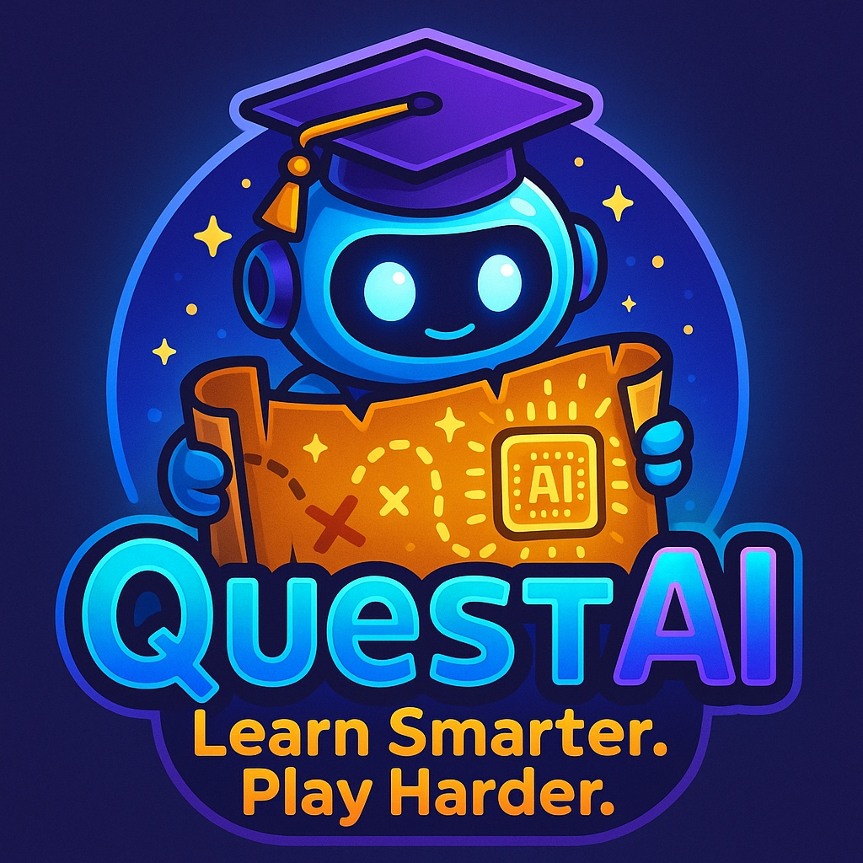
Quest AI: Learn Smarter. Play Harder.
Transforming education through AI-powered adventure
Join the Learning Adventure Today

Slide 20
Core Features & Target Market
AI Personalization
Our AI provides adaptive lessons tailored to each individual student, creating a customized learning experience that adjusts to their unique needs and pace.
Gamification
The platform features a comprehensive points, levels, and rewards system that motivates students to engage and progress through their learning journey.
Progress Tracking
Real-time dashboards for all users provide transparent visibility into learning progress and performance metrics.

Slide 21
Competitive Landscape
Competitors
QuestAI Advantage
Duolingo
Khan Academy
Mathletics
Quizlet
✓ AI + Gamification
✓ Adaptive Learning
✓ Full Curriculum
✓ Adventure Mode

Slide 22
Revenue Streams
Freemium Model
Free basic features with premium upgrades
School Licenses
Volume licensing for institutions
Premium Subscriptions
Advanced features and analytics

Slide 23
Growth Roadmap
Phase 1
Core Platform
Phase 2
School Partnerships
Phase 3
Global Expansion
Phase 4
Advanced Features

Slide 24
Team Structure
💻
Developers
App creation & updates
🎨
Designers
UI/UX & visual layout
💬
Support Staff
Customer assistance

Slide 25
Risk Mitigation Strategies
Competition: Continuous innovation and unique AI features
Technology: Regular updates and version control
Data Privacy: Encryption and compliance with regulations
User Acquisition: Strategic partnerships with schools
Budget: Phased rollout to manage costs

Slide 26
Key Success Metrics
10K+
Users by Year 1
50+
Schools Partnered
4.5+
App Store Rating

Slide 27
Join the Learning Adventure
Transform education through AI-powered gamification
Learn More at QuestAI.com

